Slide 1
What is Internet?
Whatever we can see online is because of internet.
The Internet also called as net.
It is a worldwide system of computer networks.
By using Internet we can share any information online from one Pc to another.

Slide 2
HTTP
Hypertext Transfer Protocol.
It is the rule book for transferring any files eg. such as text, images, sound, video etc.
And it is possible through web, when user open a browser they are indirectly using HTTP.

Slide 3
HTTPS
Hypertext Transfer Protocol Secure.
It is an extension of HTTP.
More secure and widely used on internet.
Secure Socket Layer (SSL)/Transport Layer Security (TLS) protocol.

Slide 4
WWW
World Wide Web
World Wide Web, which is also known as a Web.
It is a collection of websites or web pages stored on web servers and connected to local computers through the internet.
These websites contain text pages, digital images, audio, videos, etc.

Slide 5
Domain Name
It is the name of a website.
It's what comes after "@" in an email address, or after "www." in a web address.
If someone asks how to find you online, what you tell them is usually your domain name.

Slide 6
Top Domain Name
.com
.org
.in

Slide 7
SEO
Search Engine Optimization.
It is the process by which we get our website on top in search engine result page(SERP).
Digital Marketer use it to rank website on top of SERP.
It's our responsibility to make a website Seo Friendly .

Slide 8
What is HTML?
HTML stands for HyperText Markup Language.
It is used to structure the web page
It is a scripting language which used by browser to render the page on WWW(World wide web).
It is not a programming language.
it is markup language. Html is parsed by the browser and then browser display the web page.
It consist a series of element.
It tells browser how to display web page.

Slide 9
What is text editor.
Editors are basically computer programs that are utilised to edit files on a computer.
They provide environment to a programmer to create, edit, update, format a document in any order he/she wants to. In system programming or programming, editors are software or tools that are used to edit the program.
Visual studio code
sublime
Notepad++

Slide 10
Web Browser
It is a an application to explore world wide web.
It provide a interface between user and server.
whatever a client or user want to see web browser helps to display the content.
The information which we want to display through web browser is transferred from HTTP.

Slide 11
Downloading Text Editor
https://code.visualstudio.com/download
from here we can download text editor.
During our course we will use Vs code as a text editor.

Slide 12
HTML Structure
Html structure is mainly divided into two parts.
Head
It contains the information about the Html document. Like meta data, title, version, links etc.
Body
It contain everything which we want to display on internet.

Slide 13
Structure
<!DOCTYPE html>
<html>
<head>
<title>Title of page</title>
</head>
<body>
<h1>Heading</h1>
<p>Paragraph</p>
</body>
</html>

Slide 14
First Program in HTMl
<!DOCTYPE html>
<html>
<head>
<title>Tops Technologies</title>
</head>
<body>
<h1>Tops</h1>
<p>Best It Institute in Gujarat</p>
</body>
</html>

Slide 15
HTML Introduction
Html stand for Hypertext Markup Language.
It consist a series of element.
It describe a structure of a web page.
The element of html tells the browser how to display content.
Tim Berners Lee in 1993 first introduce the version of Html.

Slide 16
HTML Getting started
What is html?
structure of html
introduction of html

Slide 17
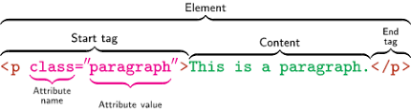
HTML Element
first <html> is the root element of Html document it defines the html document.
an html element consists of an opening tag - some content - closing tag.

Slide 18
HTML Attributes
they are used in html tag to change the behaviour of element or display of element.
with the help of attributes we can change the color, size, fonts or whatever we want to change in an element.
https://developer.mozilla.org/en-US/docs/Web/HTML/Attributes here we can check the various attributes used in html.
They always come in start tag. Like <starttag name=”value”>content</endtag>
for eg.
<a href="https://developer.mozilla.org/en-US/docs/Web/HTML/Attributes">Visit For attributes</a>

Slide 19
HTML Basic Tags
<!DOCTYPE html>
<html>
<head>
<title>
<body>
<h1> to <h6>
<p>
<br>
<hr>
for more https://developer.mozilla.org/en-US/docs/Web/HTML/Element

Slide 20
HTML DOCTYPES
It is a first line of code when we write html document.
It is a declaration of html document.
it tells the browser that in which version we are writing the html document.
It is not a tag it is just a declaration for telling the browser that what version we are using and then browser display accordingly.
This is written as <!DOCTYPE html>

Slide 21
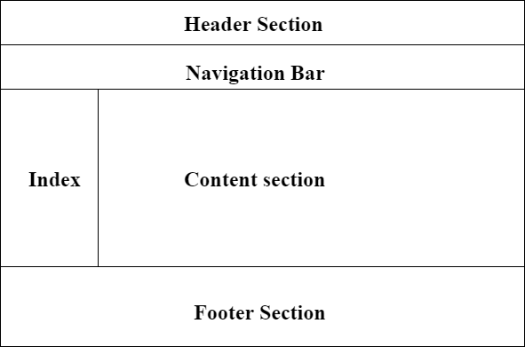
HTML Layout

Slide 22
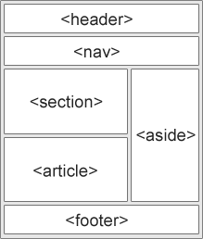
HTML Layout
Html layout consist of several element like header, nav bar, section, article, aside, footer etc.

Slide 23
<!DOCTYPE html>
<html lang="en-US">
<head>
<meta charset="utf-8">
<meta name="viewport" content="width=device-width">
<title>My page title</title>
<link rel="stylesheet" href="style.css">
</head>
<body>
<header>
<h1>

Slide 24
</header>
<nav>
<ul>
<li>Home</li>
<li>Our team</li>
<li>Projects</li>
<li>Contact</li>
</ul>
<form>
<input type="search" name="q" placeholder="Search query">
<input type="submit" value="Go!">
</form>
</nav>

Slide 25
<main>
<article>
<h2>heading 2</h2>
<p>para </p>
</article>
<aside>
<h3>heading 3</h3>
</aside>
</main>
<footer>
<p>para</p>
</body>
</html>

Slide 26
HTML Head
As we earlier discussed about Html head that what it consist :-
So it contain some meta information such as document, style, script, title etc.which are machine readable like browser wants these info and act accordingly.
for eg.
<!DOCTYPE html>
<html lang="en-US">
<head>
<meta charset="UTF-8">
<meta name="viewport" content="width=device-width">
<title>Document title</title>
</head>
</html>

Slide 27
HTML Meta
it contain some meta information which are generally meant for browser to read and display page accordingly.
such as base, script, style, title, link etc.
which character set we are using , viewport etc.
These meta info are always written in the head section of a html document.
For eg as i mentioned in meta.html file

Slide 28
HTML Script
This is used for adding javascript to html document..
Syntax for adding javascript is
<script> </script>
for eg i mentioned in script.html

Slide 29
Create Any Simple Web Page To Show Our Name
for this watch my name.html

Slide 30
Importance of Meta Tag and Doctypes
As we discussed about both of them in our earlier lecture that what is the importance of Doctype in Html and Meta tag in Html.
Doctype is used for telling version to browser
meta tag is used to tell browser that what we are using and in what way browser will display web page.

Slide 31
Tags and Self Closing Tags
So, there are several tags in html and some don't need to be closed.
that tags which don't need to be closed are called void tag or empty tag.
so here is the list of html tags
https://developer.mozilla.org/en-US/docs/Web/HTML/Element
some self closing tags which are commonly used are <br>, <hr>, <img> etc

Slide 32
Attributes and Events
As we already discussed about what is attributes and why we use them in our earlier lecture.
for reference
https://developer.mozilla.org/en-US/docs/Web/HTML/Attributes

Slide 33
Marquee Tag
The Marquee tag is used for creating scrollable text or image in a web page.
But now this tag is been depreciated in html 5 i.e not so important now in html 5
for eg as i mentioned in marquee.html

Slide 34
HTML Comments
when we want write something to remember in text editor like vs code.
we have to comment it in our html document so that browser don't show it on web.
<!-- comments here -->

Slide 35
HTML Image
For display a image in html document we use img tag
syntax for img tag is
<img src=”image.jpg” alt=”Image” width=”100px” height=”100px”>
src and alt are required attributes in img tag.
src defined the path of the image
alt is alternative text for image when the image for some reason can not be displayed

Slide 36
if we want to hyperlink an image we insert img in anchor tag
<a href=”Some link here.com”>
<img src=”image.jpg” alt=”Image”>
</a>
for reference I mentioned in image.html

Slide 37
HTML Tables
For reference go to table.html

Slide 38
HTML Lists
Types of list in html document.
ordered list - it starts with <ol>
unordered list - it starts with <ul>
Description list - it starts with
<dl>
<dt>Coffee</dt>
<dd> - hot drink </dd>
<dt>Tea</dt>
<dd> -cold drink </dd>
</dl>
<li> is List Item
for further eg go to list.html

Slide 39
HTML Text Links
Links are hyperlinks in html document.
links are given in html document to go through them to another page.
Text links are when we use link on text i.e when we click on some text we will be redirected to another page
syntax for link is
<a href=”url”>text here</a>.
For eg go to my links.html

Slide 40
Absolute url
the full address of link
Relative Url
local link of a page in same website
we can link to an Image
we can link to an Email Address
we can link to a button by using JavaScript.

Slide 41
HTML Heading and Paragraph
html heading are from <h1> to <h6>
paragraph <p> tag

Slide 42
HTML Text formatting
these are designed to display special type text
<b> - Bold text
<strong> - Important text
<i> - Italic text
<em> - Emphasized text
<mark> - Marked text
<small> - Smaller text
<del> - Deleted text
<ins> - Inserted text
<sub> - Subscript text
<sup> - Superscript text

Slide 43
HTML Styles
Html style means that how we write our html document.
first we have to write the declaration Doctype such as <!DOCTYPE html> in our html document.
html allows us write code in whatever we use like lowercase, uppercase letters.
but for best practice always try to use same letters and specially lowercase because it is easy to write and looks good in html document.
we have to close our html tags every time we use them
Always remember that we must have to quote our attributes value
always try to specify alt in image our in any other tag width and height given to any image looks good
title is very important so always write it

Slide 44
viewport always mention
metadata always mention
language
comments any thing which is not in code or something which you wrote for your purpose to remember when you saw it again

Slide 45
HTML Frame
Html frame are now not use in html5 i.e it does not support frame

Slide 46
HTML Iframe
It is an inline frame or we can say the context is nested in it.
we can embed any other browsing context in it
for reference go to my iframe.html
https://developer.mozilla.org/en-US/docs/Web/HTML/Element/iframe

Slide 47
HTML Blocks and Inline
There are 2 type of display values
=> Block
=> Inline
In block level every time it starts form new line and takes full width
Such as <p>, <div> etc
In Inline level it takes only required space
Such as <span> <a> etc
for reference go to my block.html page
https://developer.mozilla.org/en-US/docs/Web/HTML/Block-level_elements
https://developer.mozilla.org/en-US/docs/Web/HTML/Inline_elements

Slide 48
HTML Image Map
https://www.image-map.net/
For reference visit my mapping.html

Slide 49
HTML Forms
Html forms is used for taking users information or user data.
<form> tag is used to create a form
for reference visit my form.html page

Slide 50
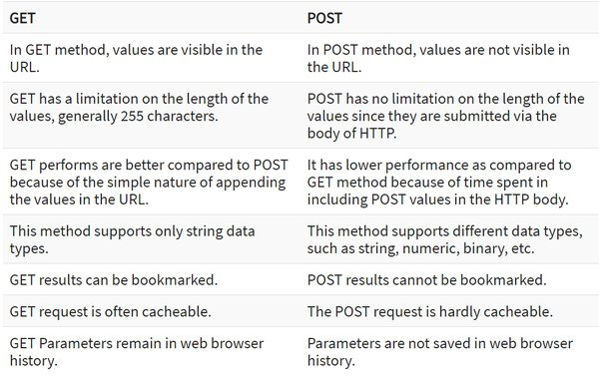

Slide 51
HTML Tags Reference
https://developer.mozilla.org/en-US/docs/Web/HTML/Element
Html tags are used to create a element.
for more reference go to my tag.html page.

Slide 52
HTML ASCII Code
ASCII stands for American standard Code for Information Interchange.
These are also called as Html Entities.
for reference https://www.tutorialspoint.com/html/html_entities.htm
for more reference visit my entity.html page

Slide 53
HTML Fonts
html fonts are same as we have fonts in Ms word etc
but in html the html fonts are now applied by using CSS font family property.
for more reference visit my font.html page

Slide 54
HTML Color
html color tag is also a deprecated tag in html.
now we use CSS properties to give color in html document
for reference visit my color.html page

Slide 55
HTML Deprecated tag
the tags which are not longer in use.
https://www.geeksforgeeks.org/html-deprecated-tags/

Slide 56
HTML Multimedia
Multimedia are images, video, audio, records, animation etc
Html element <video> is used to insert video on web page.
Html element <audio> is used to insert audio (music) in web page.
for reference go to my page media.html

